Slide 1

JU COURSE MATERIALS ADOPTION PROCESS
Instructions on submitting adoptions through the Adoptions and Insights Portal (AIP)

Slide 2

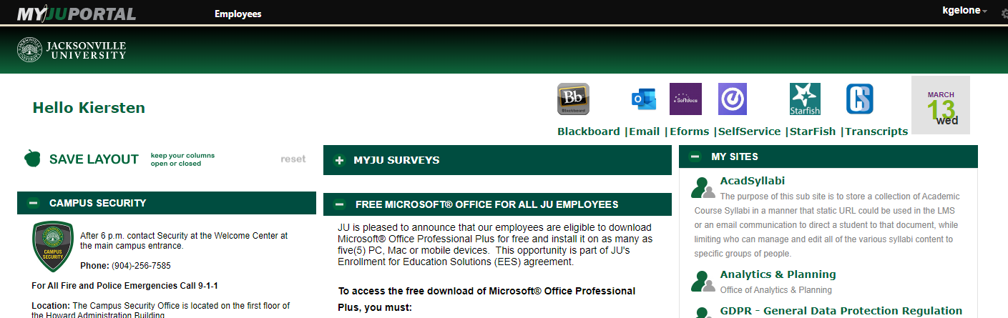
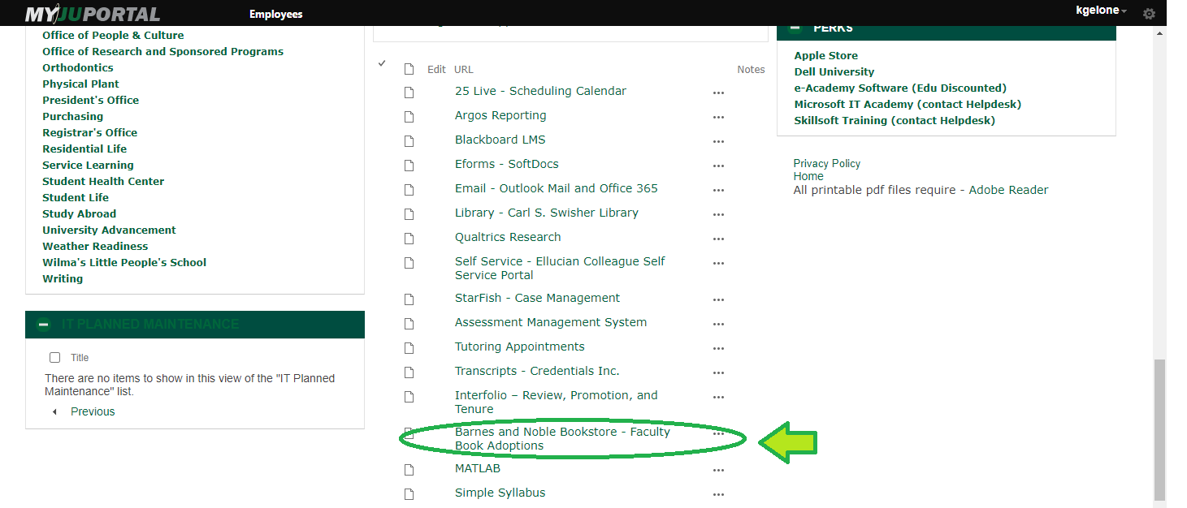
Adopting Course Materials
Click on the link found on the My JU Portal website for textbook adoptions
To submit your textbook and instructional materials adoption online, please use the Adoptions Insight Portal and log in using your NID and NID password.
Or visit aip.bncollege.com
JU Bookstore

Slide 3
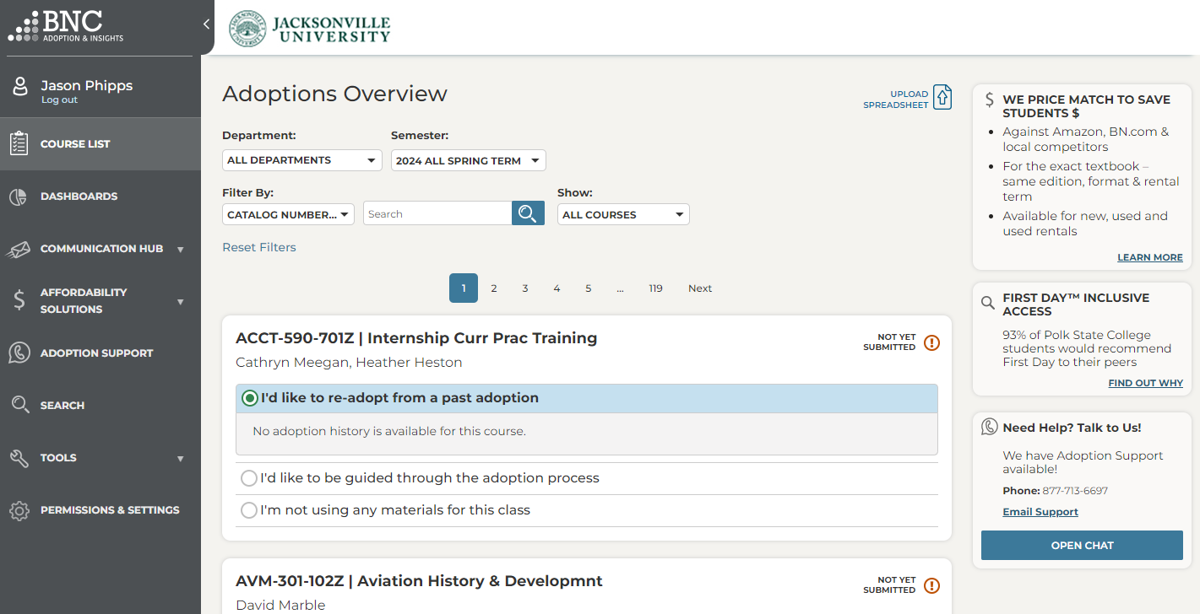
Adoptions & Insights Portal
Login to the Adoptions and Insights Portal (AIP) using your NID and NID Password
Click on Course List (Found on the left column of the page.)
Courses you are assigned to teach will be listed on the middle of the page.
Find the course you would like to adopt for.
Demo Video: https://www.youtube.com/watch?v=rTnuv7X63y8
JU Bookstore

Slide 4
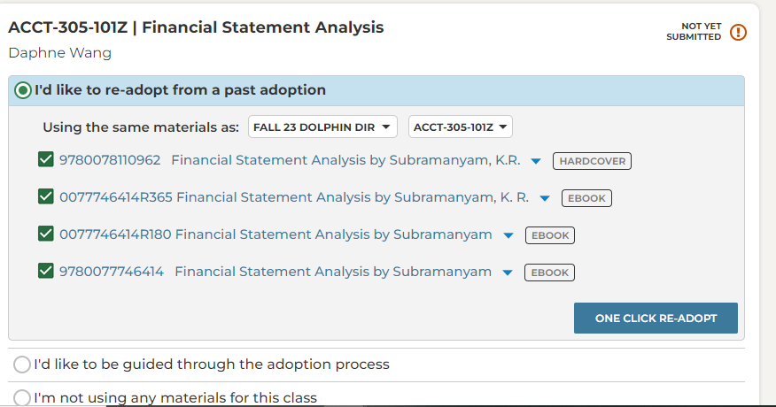
One Click Re-Adopt
To Re-Adopt from a past term, use the One Click Re-Adopt function
Select which term you want to use
Deselect any materials you don’t want to Re-adopt
If teaching multiple sections, apply your course materials to all or just submit one
Click Submit Adoption
That’s it!
JU Bookstore

Slide 5
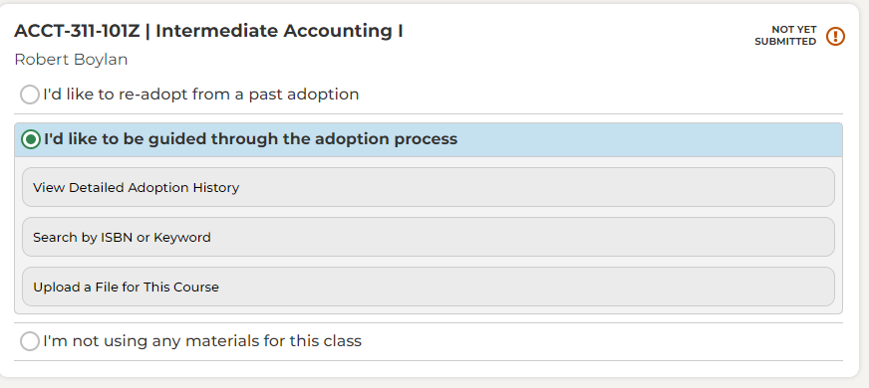
Guided Adoptions
To find new course materials, select the “I'd like to be guided through the adoption process"
View Detailed Adoption History by term, course, or professor
You can also Search by Keyword or ISBN
View textbook summary, pricing for students, and savings
Select if book is Required or Recommended
Click Add to Course to add as many ISBNs as you need before clicking Submit Adoption
JU Bookstore

Slide 6
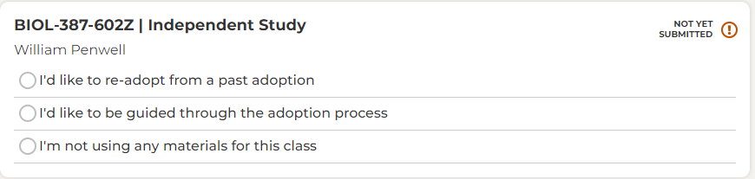
No Materials Required
If your course is not using ANY course materials, then you can select “I’m not using any materials for the course”.
If your course is using any instructional materials, (access codes, OER, school supplies - even if the item is not sold through the bookstore), submit the adoption through AIP.
Please contact the UCF Campus Store Textbook Department if you need assistance at 407-823-3355 or textbooks@ucf.edu.
JU Bookstore

Slide 7
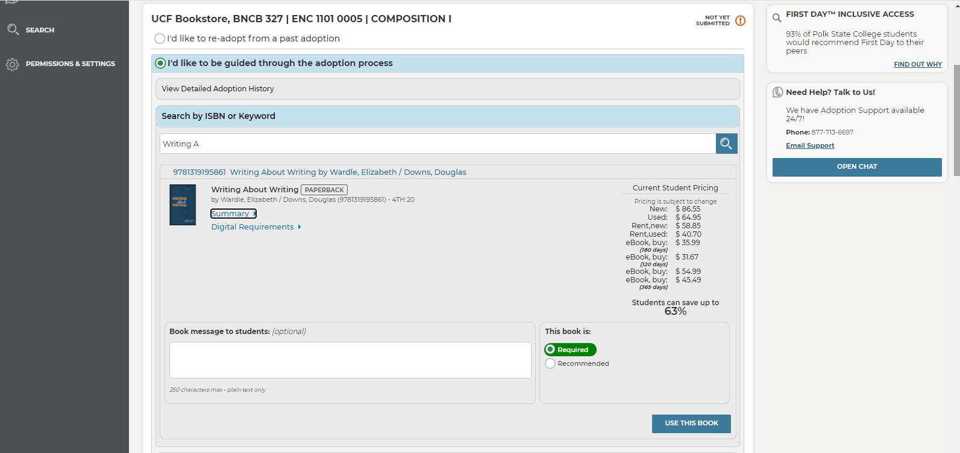
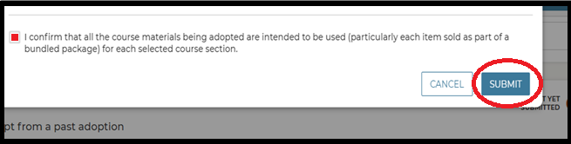
Confirming Materials
Click the box to confirm these materials will be used for the upcoming semester.
Click Submit
JU Bookstore

Slide 8
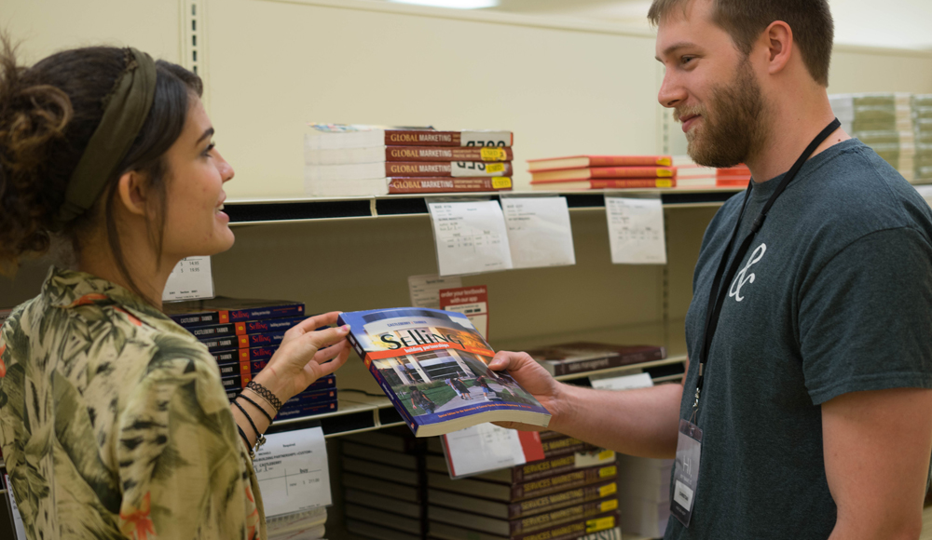
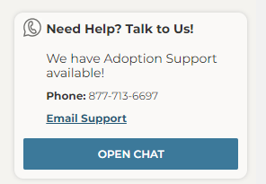
Thank you!
Need AIP Help? Talk to Us!
We have Adoption Support available 24/7!
Phone: 877-713-6697
Chat Box in AIP
JU Bookstore Support
Email: jubookstore@ju.edu

